Slide 1
MARINDUQUE
Jeffrey Cepedoza
Ivan John Naparota

Slide 2
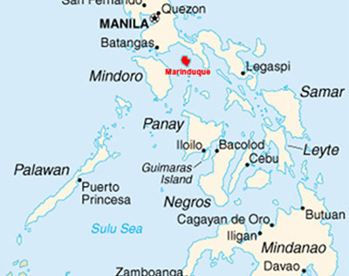
Location [1].
island province in the Philippines located in Southwestern Tagalog Region or MIMAROPA
Its capital is the municipality of Boac
http://umich.edu/~snre492/Jones/marcopper.htm

Slide 3
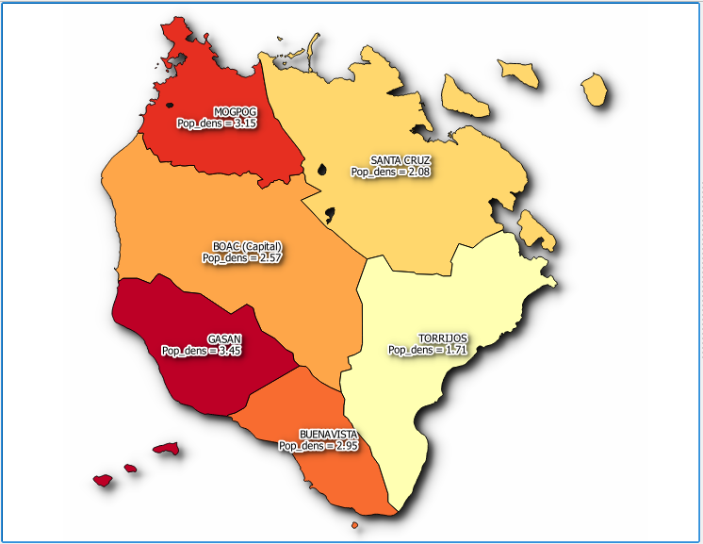
Marinduque’s Population Density

Slide 4
Municipalities [4]
MUNICIPALITY | POPULATION | LAND AREA
BOAC(CAPITAL) | 54730 | 212.70 sq. km
BUENAVISTA | 23988 | 81.25 sq. km
GASAN | 34828 | 100.88 sq.km
MOGPOG | 34043 | 108.06 sq. km
SANTA CRUZ | 56408 | 270.77 sq. km
TORRIJOS | 30524 | 178.92 sq. km

Slide 5
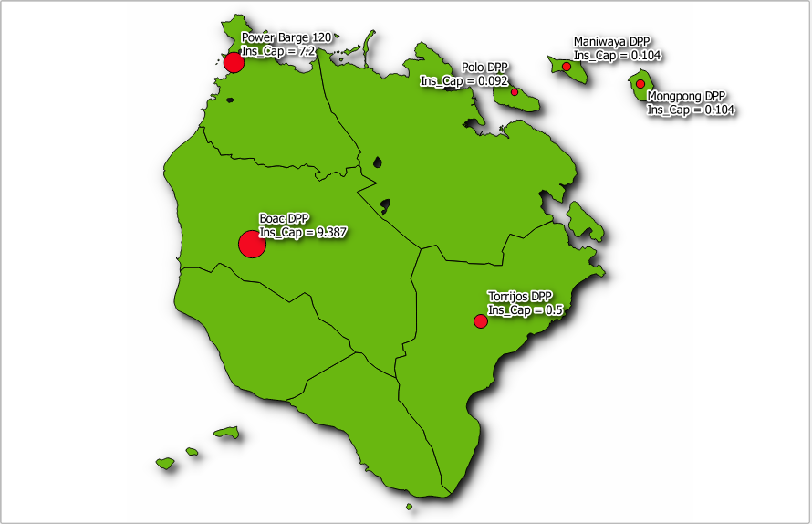
Existing Power plants in Marinduque

Slide 6
Record
POWER PLANT | OPERATING HOURS | RATED | DEPLOYED | ANNUAL GENERATION | ACF | FUEL TYPE
BOAC DPP | 24 HOURS | 3.672 MW | 3 MW | 26280 MWh | 49 % | DIESEL
MONARK EQUIPMENT CORPORATION | BACK UP | 5.715 MW | 4 MW |  |  | DIESEL
TORRIJOS DPP | BACK UP | 0.5 MW | 0.46 MW |  |  | DIESEL
POWER BARGE 120 | 24 HOURS | 7.2 MW | 4.6 MW | 40296 MWh | 52% | DIESEL
MANIWAYA DPP | 8 HOURS | 0.104 MW | 0.098 MW | 286.16 MWh | 31.41 % | DIESEL
MONGPONG DPP | 8 HOURS | 0.104 MW | 0.098 MW | 286.16 MWh | 31.41 % | DIESEL
POLO DPP | 8 HOURS | 0.092 MW | 0.088 MW | 256.96 MWh | 31.88 % | DIESEL
TOTAL |  |  |  | 67405.28 MWh

Slide 7
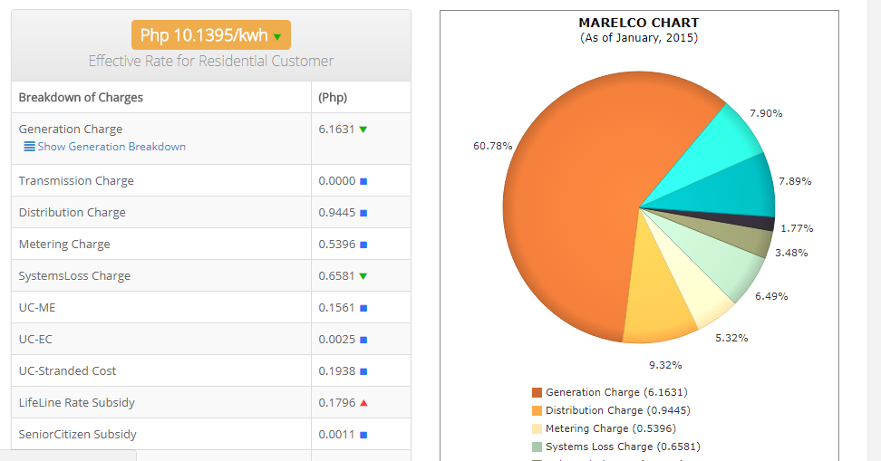
GENERATION CHARGE
Generation Charge is 6.1631 Php / kWh
From http://kuryente.org.ph/electric-company/rates/41

Slide 8
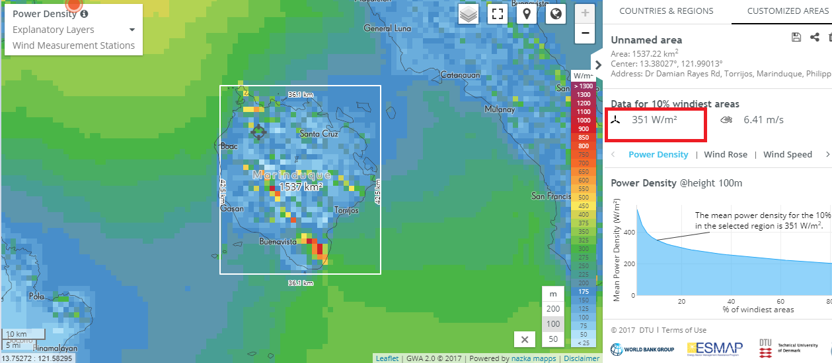
Wind Energy Assessment via Global Wind Atlas
https://globalwindatlas.info/area/Philippines/Region%20I%20(Ilocos%20region)

Slide 9
The Whole Region
at 100m elevation, 10% windiest area in the region tallies 351 watts per square meter mean power density
just by looking at the legend shown in the GUI and observing at the region, the power per square meter of almost the whole region is not that high, but

Slide 10
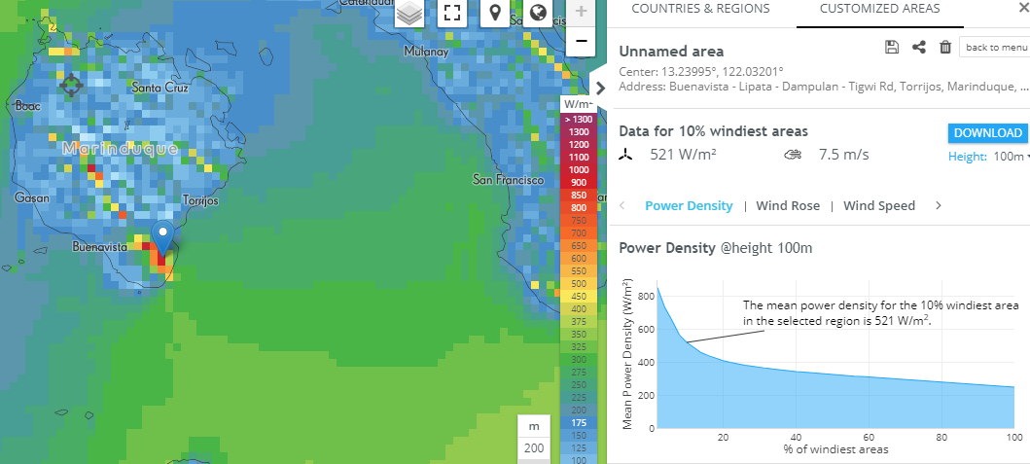
Point Clicking on the “Redest” Portion
After point clicking on the “redest” portion of the region which is at Buenavista, Marinduque, it will give us a relatively larger mean power density of 521 watts per square meter, this is at 100 m elevation

Slide 11
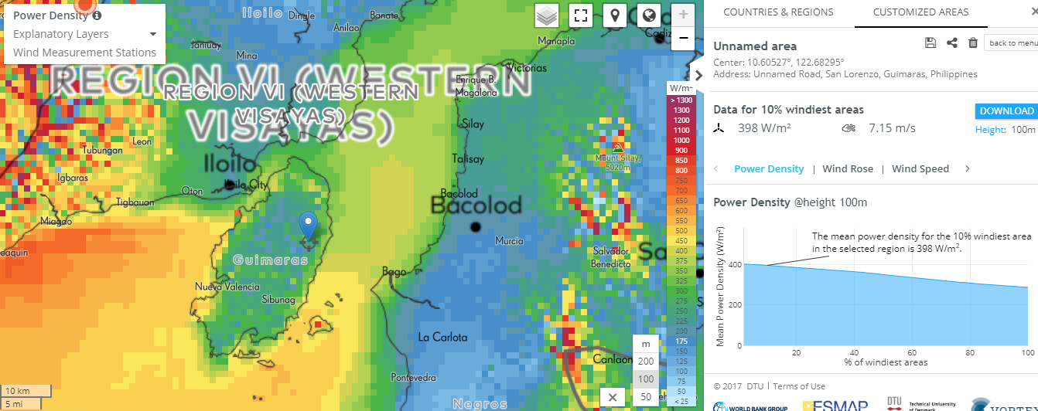
Let us compare it to San Lorenzo, Guimaras

Slide 12
San Lorenzo, Guimaras is the location of one of Philippines’ wind energy farm, the San Lorenzo Wind Farm (50 MW installed capacity)
San Lorenzo has a mean power density of 398 watts per square meter
The recorded mean power density of Marinduque is relatively larger than the mean power density of San Lorenzo

Slide 13
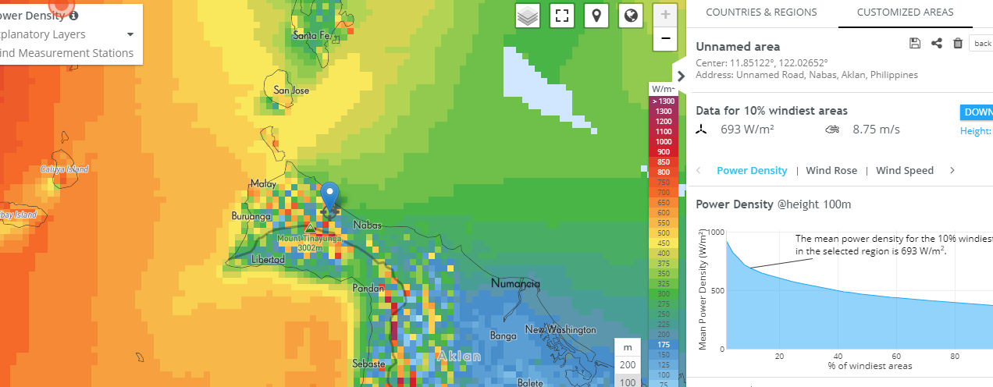
Nabas, Aklan Comparison

Slide 14
36 MW wind energy source is located in Nabas, Aklan
Mean power density due to wind in Nabas, Aklan is relatively larger than of Marinduque’s but it does not have that much of a difference

Slide 15
Implication
Marinduque’s potential for wind energy source is noticeable
Proposing a wind energy farm in Buenavista, Aklan is reasonable for it has the biggest mean power density across the region of Marinduque
Marinduque’s potential for wind energy source is complemented by its large land area, Buenavista has a land area of 81.25 sq. kilometer and according to [6], “a 2-megawatt wind turbine would require a total area of about half a square kilometer”, making it even more possible to build a wind energy farm in Buenavista, Marinduque

Slide 16
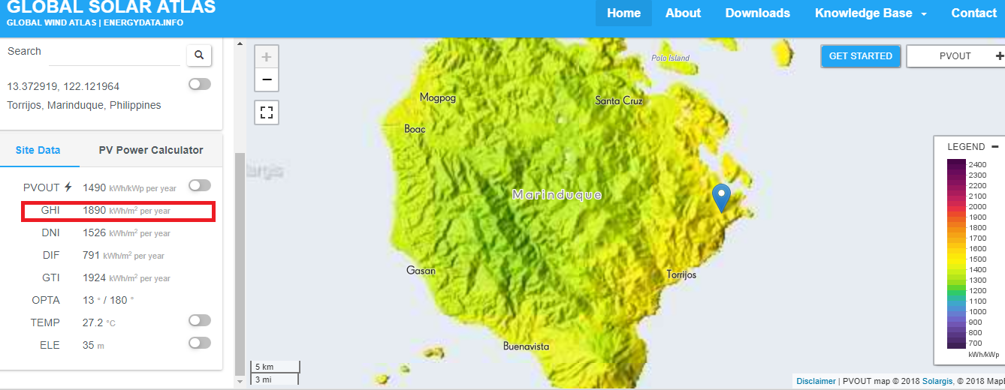
Solar Assessment via Global Solar Atlas

Slide 17
Implication
It is observable in the GUI of Global Solar Atlas that Torrijos, Marinduque has the largest Global Horizontal Irradiance across the Marinduque region, it has a high potential for solar energy having a GHI of 1886 kWh per square meter.
Also, it is favourable that Torrijos would be the place for the solar farm because the municipality has the least population density of only 170 persons/sq.km [4] and having a very large land area of 178.92 sq. km [4]

Slide 18
Buenavista, Marinduque Wind Data (m/s)
Lat 13.248 Lon 121.981 | Jan | Feb | Mar | Apr | May | Jun | Jul | Aug | Sep | Oct | Nov | Dec
10-year Average | 6.59 | 5.69 | 5.28 | 4.17 | 3.36 | 4.48 | 4.26 | 5.55 | 4.24 | 4.55 | 5.96 | 7.00
This is a 10 year average wind data from NASA’s free access database.
Link: https://eosweb.larc.nasa.gov/cgi-bin/sse/grid.cgi?email=skip@larc.nasa.gov

Slide 19
Torrijos, Marinduque Horizontal Insolation (kWh/m^2/day)
Lat 13.334 Lon 122.016 | Jan | Feb | Mar | Apr | May | Jun | Jul | Aug | Sep | Oct | Nov | Dec
22-year Average | 4.34 | 5.09 | 5.84 | 6.53 | 6.18 | 5.32 | 4.99 | 5.11 | 4.93 | 4.51 | 4.12 | 3.87
This is a 22 year average of horizontal insolation data from NASA’s free access database.
Link: https://eosweb.larc.nasa.gov/cgi-bin/sse/grid.cgi?email=skip@larc.nasa.gov

Slide 20
Hybrid System Design
Design a Hybrid System that can supply the island’s energy needs
Hybrid system composed of wind and solar renewable energy sources and the existing diesel power plants
Consider limiting the carbon emission in designing
HOMER is employed to design an optimized hybrid system

Slide 21
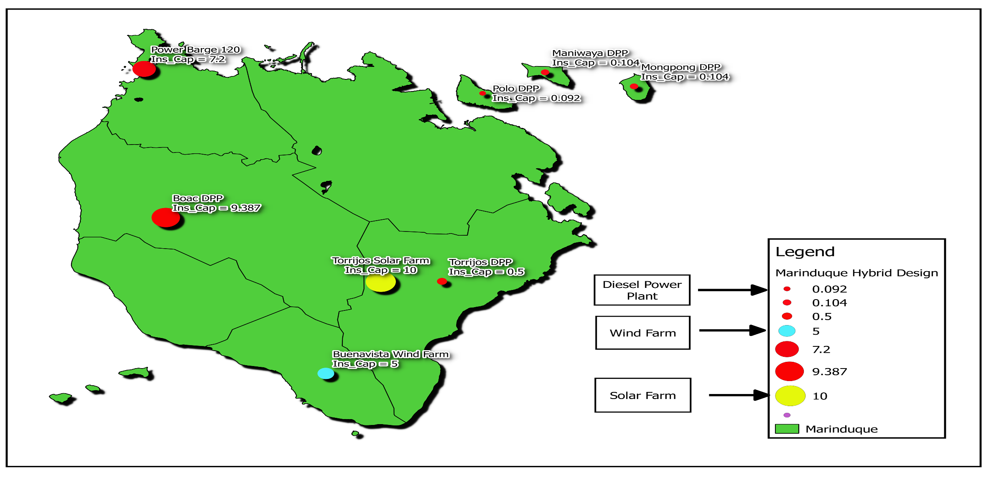
Map of proposed RE’s along with existing DPP’s

Slide 22
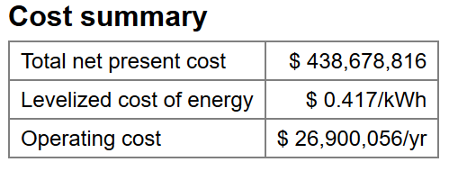
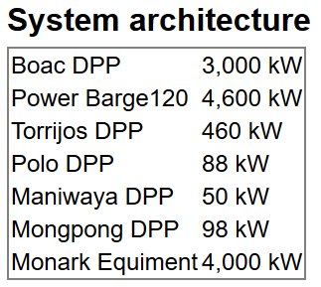
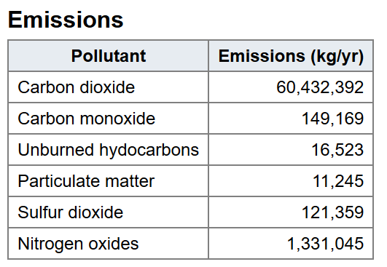
Carbon Emission and LCOE from existing DPP’s solved in HOMER

Slide 23
Specifications of Components
COMPONENTS | CAPACITY
BOAC DPP | 3000 kw
MONARK EQUIPMENT CORPORATION | 4000 kw
TORRIJOS DPP | 460 kw
POWER BARGE 120 | 4600 kw
MANIWAYA DPP | 50 kw
MONGPONG DPP | 98 kw
POLO DPP | 88 kw
PV ARRAY | 20000,25000,30000 kw
WIND TURBINE (WES 30) | 250 kw AC
BATTERY (300 Trojan L16P) | 2.16 kwh
CONVERTER | 15000 kwh

Slide 24
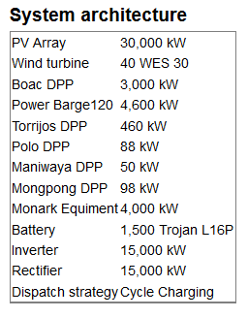
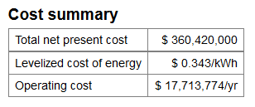
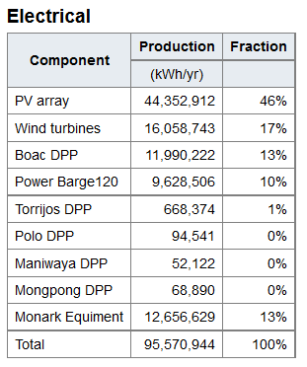
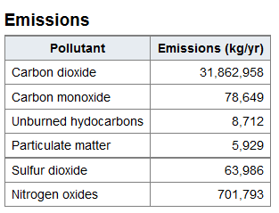
Proposed Setup (HOMER Optimized)

Slide 25
Discussions
The results from HOMER which are presented shows that the optimized hybrid system is composed of generally a 30 MW solar energy source and a 10 MW wind energy source, it is observable that it limits the usage of existing diesel power plants to only 37 % of the total energy consumption of the island, resulting in a lesser carbon emission which is about a half of the total carbon emission of the existing diesel power plants in the island, and surprisingly, the levelized cost of energy became lesser with the proposed hybrid system, from $ 0.417 to $0.343.

Slide 26
Conclusion(s)
Practicing the use of Renewable Energy is of big help in addressing problems related to CO2 emission
The island of Marinduque has a high potential for solar and wind energy

Slide 27
References
1 - https://en.wikipedia.org/wiki/Marinduque
2 - http://newsinfo.inquirer.net/926591/diesel-fired-plant-boosts-marinduque-power-supply
3 - https://deepresource.wordpress.com/2012/04/23/energy-related-conversion-factors/
4 - Census of Population (2015). Highlights of the Philippine Population 2015 Census of Population. PSA. Retrieved 20 June 2016.
5- https://carbonpositivelife.com/co2-per-litre-diesel/
6- https://sciencing.com/much-land-needed-wind-turbines-12304634.html

